Slide 1
02: Meshes & The Euler Formula
Dr. Hamish Carr

Slide 2
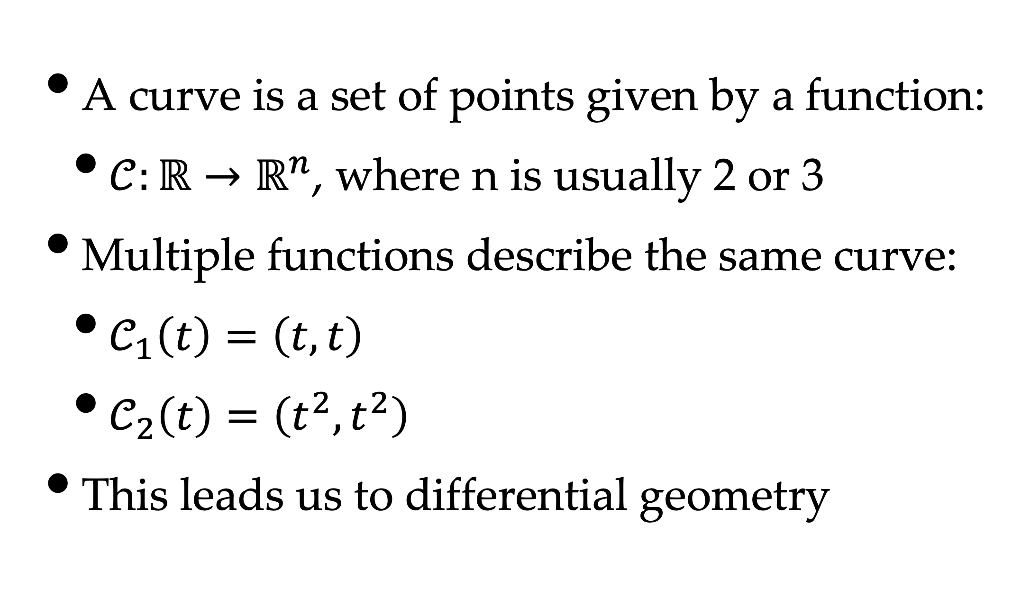
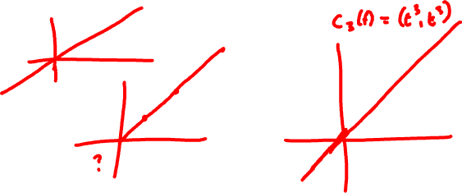
Definition of a Curve
A curve is a set of points given by a function:
$𝒞:ℝ→ℝ^{n}$, where n is usually 2 or 3
Multiple functions describe the same curve:
$𝒞_{1}\left(t\right)=\left(t,t\right)$
$𝒞_{2}\left(t\right)=\left(t^{2},t^{2}\right)$
This leads us to differential geometry

Slide 3
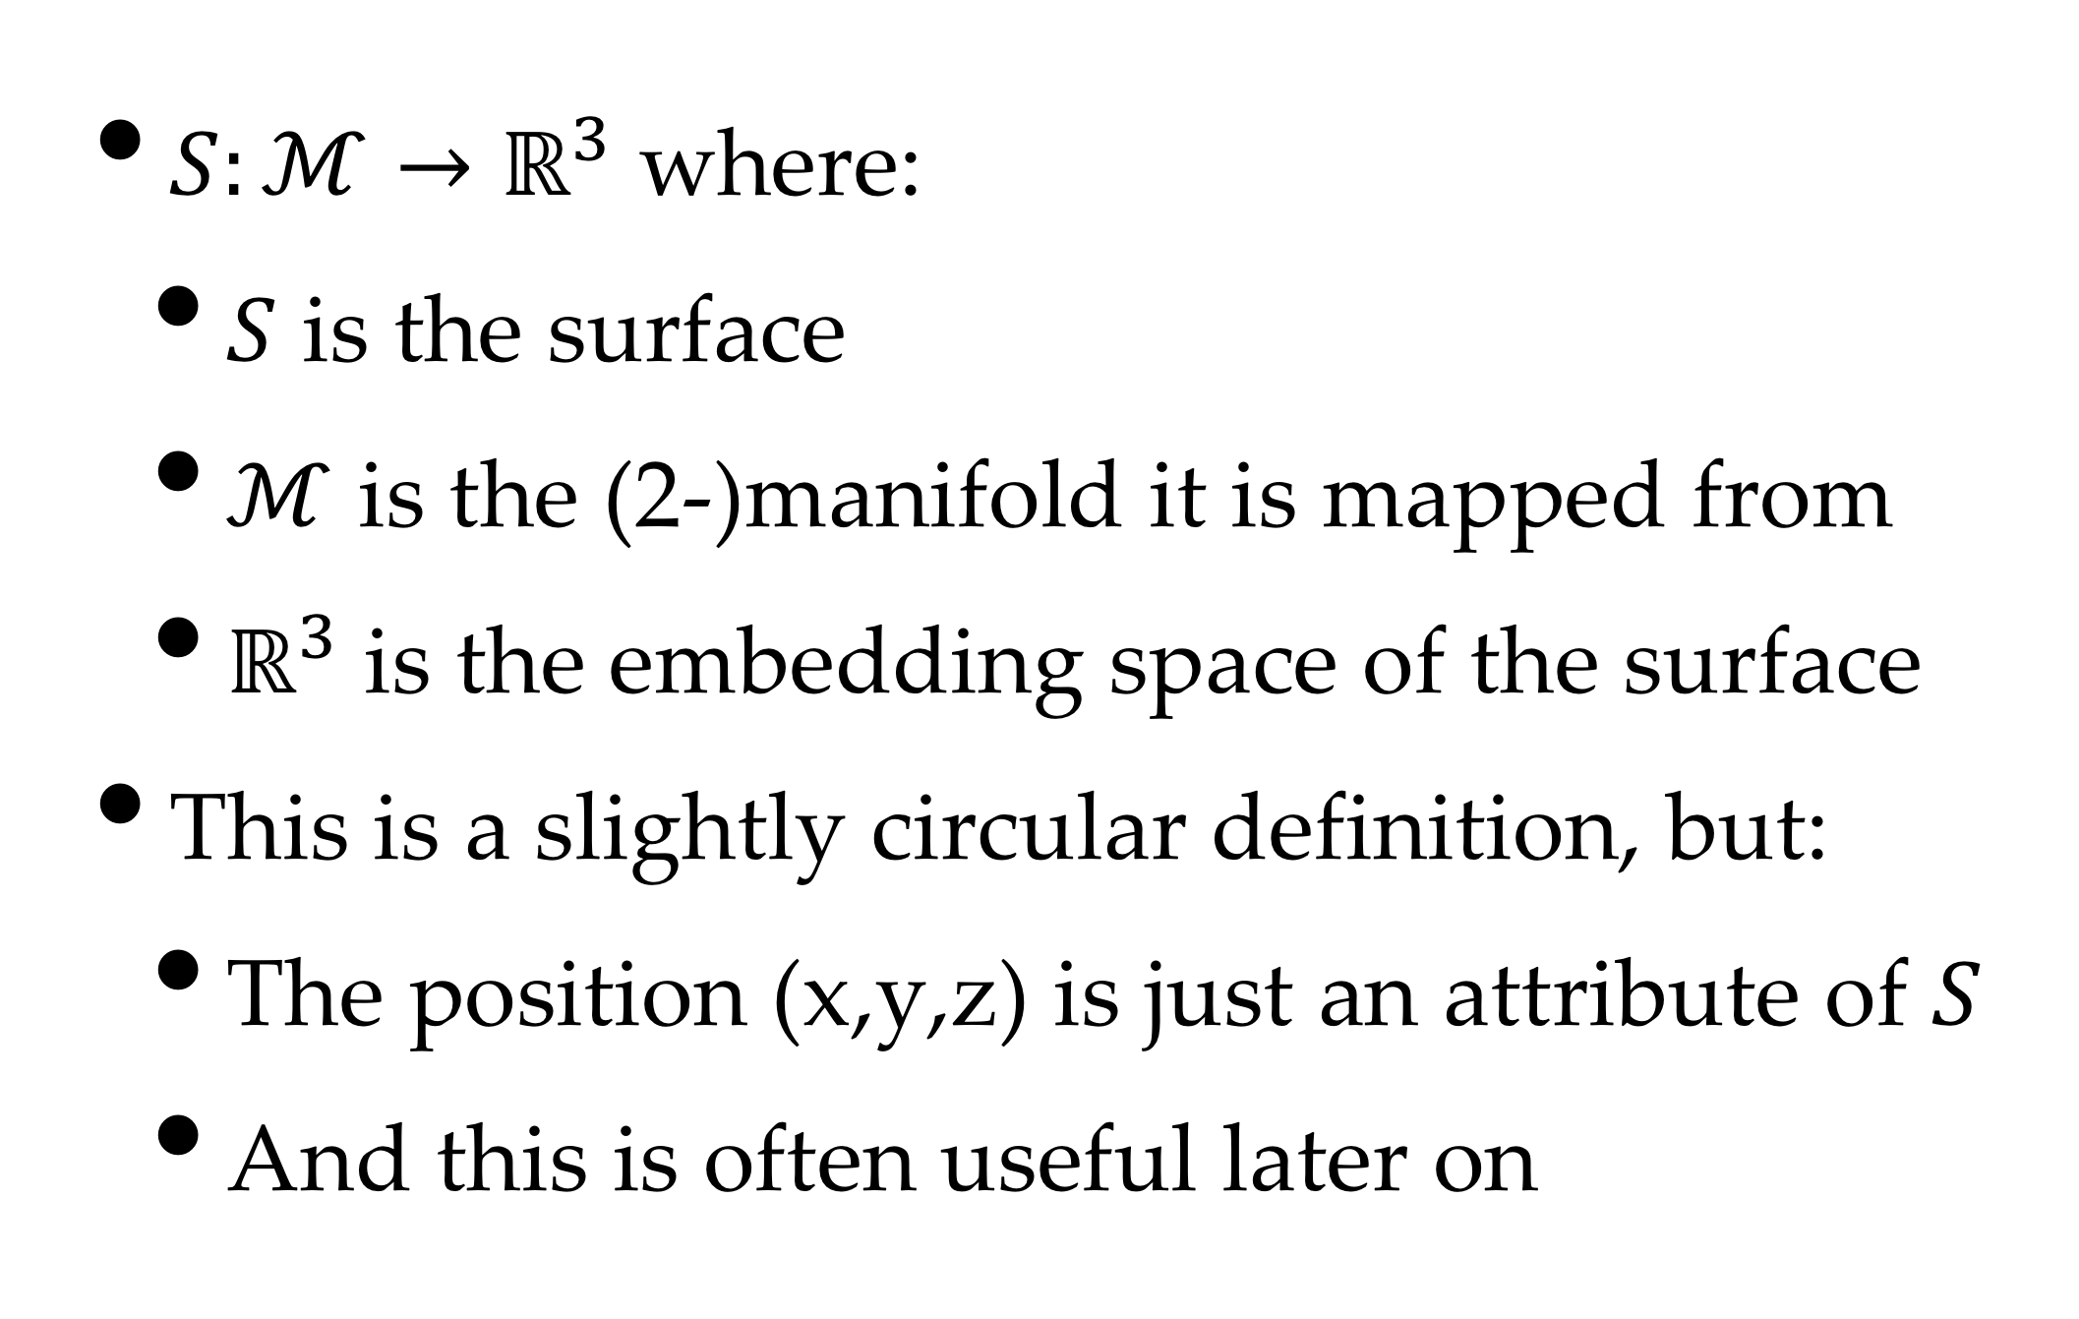
Definition of a Surface
$S:ℳ→ℝ^{3}$ where:
$S$ is the surface
$ℳ$ is the (2-)manifold it is mapped from
$ℝ^{3}$ is the embedding space of the surface
This is a slightly circular definition, but:
The position (x,y,z) is just an attribute of $S$
And this is often useful later on

Slide 4
Mathematical Ideal
Each surface is known analytically
Usually parametrised by texture cords u,v
(x,y,z) are function of (u,v)
Normal vectors are perfect
Any other property is parametrised by u,v
And can be determined when needed
But it’s not that neat in practice

Slide 5
The Reality
Can only parametrise simple surfaces
Parametrisation implies distortion
Computing intersections, &c. is expensive
And it’s hard to construct a surface
i.e. the infamous creative control
Artists want to decide what the surface is
So they need workable tools

Slide 6
The Compromise
We use meshes to represent geometry
Position, normals, tangents, &c.
We use textures & maps for properties
And store them in arrays
Using (u,v) as lookups into the arrays
And we can store any lookup we want
Heightmaps, lightmaps, shadowmaps, &c.

Slide 7
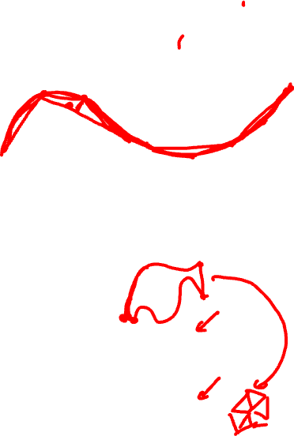
Differential Geometry
Weierstrass Theorem:
Any smooth function can be approximated with polynomials to any desired accuracy
Two basic choices:
p-refinement: more complex polynomials
h-refinement: more individual pieces
p-refinement leads to higher-order surfaces
h-refinement means more triangles

Slide 8
H-Refinement
Just add more triangles / polygons
But how?
We will need data structures
Which means discussing some basics first
And identifying the operations required

Slide 9
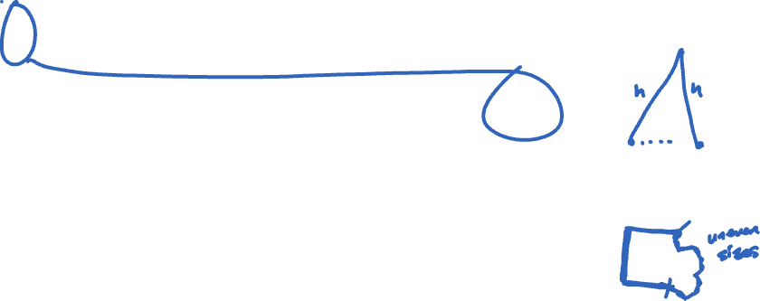
Approximation Error
Let h be the maximum edge length in M
The approximation error is O(h²)
Corollary: high curvature => more edges
Perceptual issues also kick in:
Humans pay more attention to:
Edges, movement, textural changes
Eyes, hands, ...

Slide 10
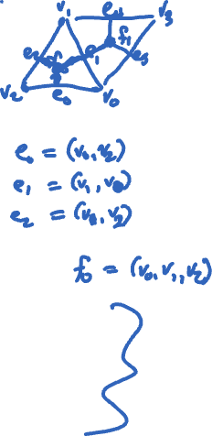
Formal Definition of Mesh
A mesh consists of:
V the vertex set (a set of indices)
E the edge set (pairs of indices)
F the face set (3+-tuples of indices)
P points – a geometric embedding of V
A attributes – extra properties
F, E, V are essentially a graph

Slide 11
Mesh Attributes
Attributes can be:
Position (x,y,z,[w])
Normal vector (nx, ny, nz)
Colour (r,g,b)
Texture coordinates (u,v,w)
Material (r,g,b + lots of extra stuff)
&c., &c., &c.

Slide 12
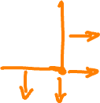
Attribute Location
Attributes can belong to:
Vertices
Edges
Faces
Or even to a given vertex on a given face
-> eg normal along sharp edges

Slide 13
Fundamental Choice
We can store attributes on the mesh itself
Or we can store attributes in textures
And store texture coordinates in the mesh
We can even store positions in textures
But mostly we do positions directly

Slide 14
Manifold Meshes
Triangle mesh is 2-manifold iff:
all edges share two faces
no pinch points at vertices
i.e. single cycle around each vertex
no self-intersections
A non-self-intersecting, closed polyhedron

Slide 15

Manifold Sketches

Slide 16
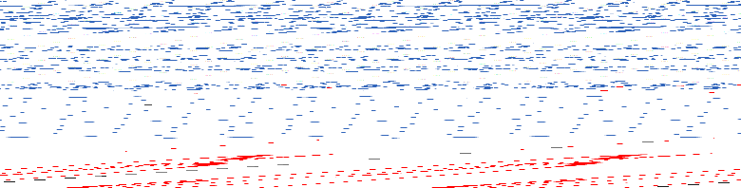
Unwrapping Meshes
Meshes unwrap to become (planar) graphs
Choose one face and cut a small circle in it
Expand it to infinity
I.e. reverse so-called one-point unification
F6
F2
F2
F5
F1
F3
F5
F1
F3
F6
F4
F4

Slide 17
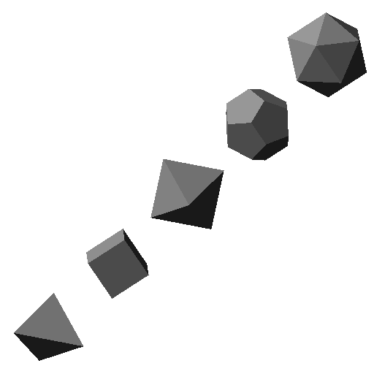
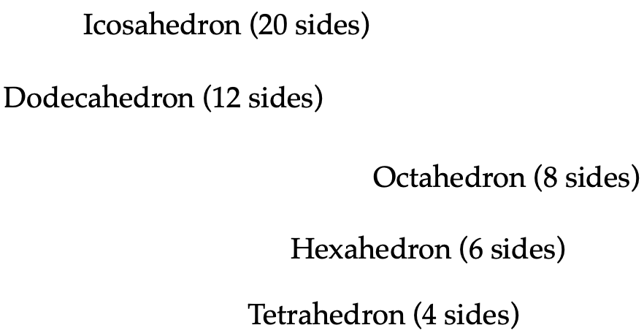
Platonic Solids

Slide 18

Tetrahedron

Slide 19
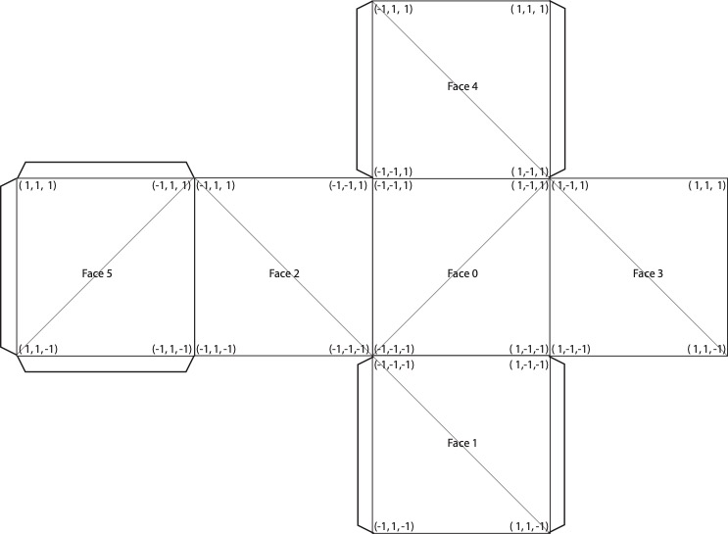
Hexahedron (Cube)

Slide 20
Octahedron

Slide 21
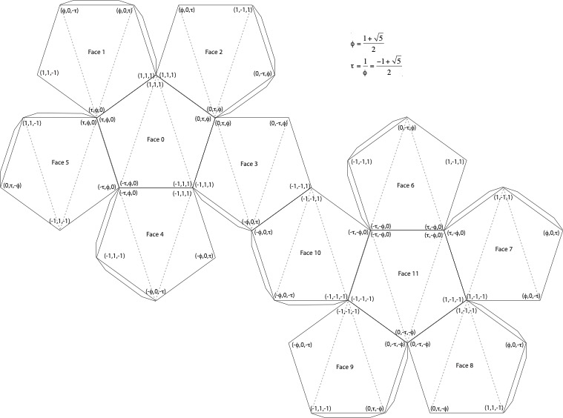
Dodecahedron

Slide 22

Icosahedron

Slide 23

Simple Polyhedra ⬄ Planar Graphs
Euler (18th c.)
But not all polyhedra are simple
There is a phenomenon called genus
The number of handles through the surface
Or the number of independent cycles
from wikipedia ...

Slide 24
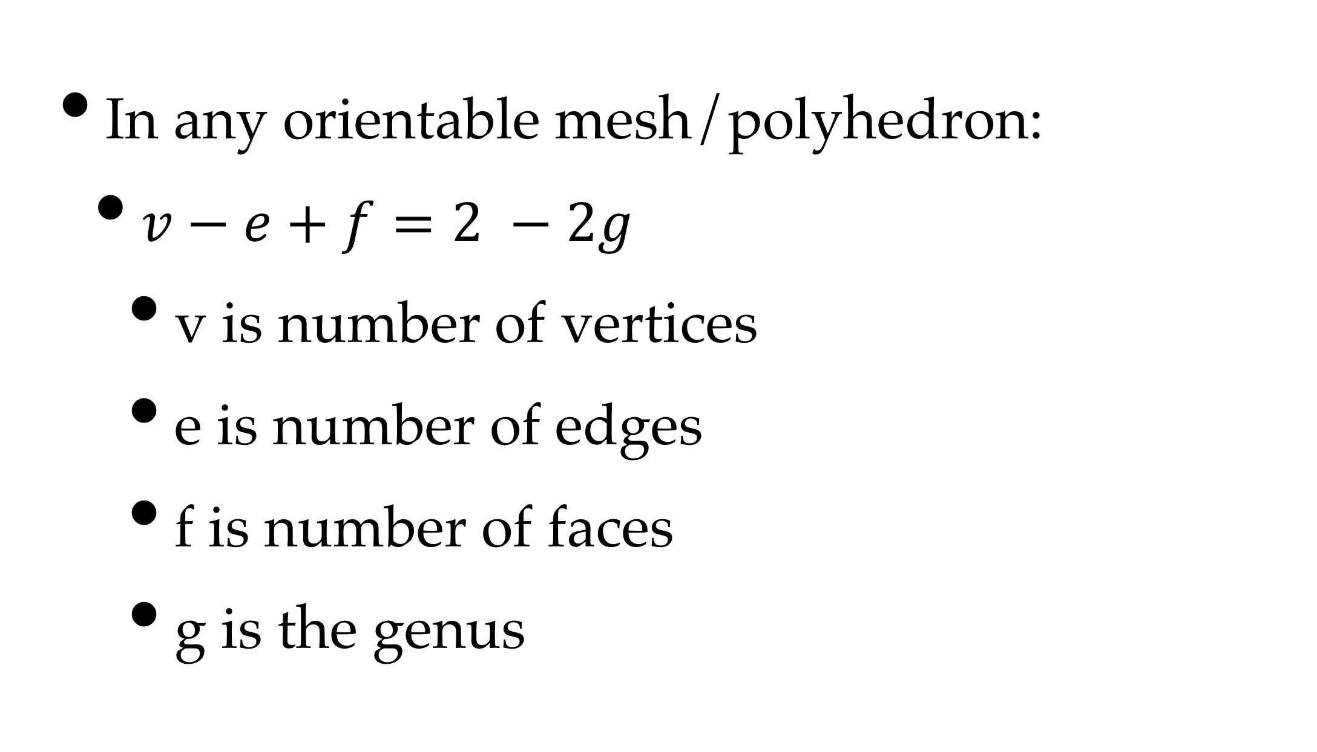
Euler's Formula
In any orientable mesh/polyhedron:
$v−e+f=2 −2g$
v is number of vertices
e is number of edges
f is number of faces
g is the genus

Slide 25
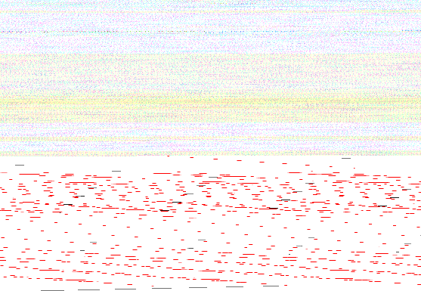

Some Examples
 | v | e | f | g
Tetrahedron | 4 | 6 | 4 | 0
Cube | 8 | 12 | 6 | 0
Octahedron | 6 | 12 | 8 | 0
Dodecahedron | 20 | 30 | 12 | 0
Icosahedron | 12 | 30 | 20 | 0

Slide 26
Sketch of Proof
Start with a single cycle with 2 faces:
Add in vertices one at a time
Keeping track of vertex count, &c.
Leads to inductive proof
The basis of nearly all planar graph algorithms
and all polygon mesh data structures, &c.

Slide 27

Sketch of Proof

Slide 28
Exercise
Convert each Platonic solid to a planar graph
Compute f, e, v and g
Remove one vertex & re-triangulate face
Repeat until done

Slide 29


Vertex-Face Duality
Put a vertex at the centre of each face
Connect faces if adjacent
Constructs new faces around vertices
Vertices & faces are dual
Tetrahedron is self-dual
Cube is dual to octahedron
Dodecahedron is dual to icosahedron

Slide 30
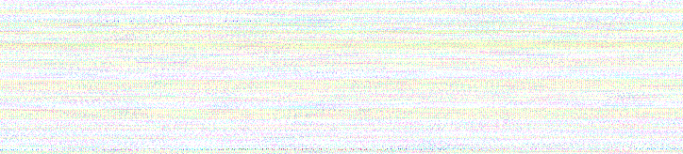
Triangulation
A mesh all of whose faces are triangular
And therefore easy to work with
Vertices can be arbitrary degree
But not 0, 1, or 2
Can always be constructed
e.g. barycentric face refinement
Therefore, the base assumption for everything

Slide 31
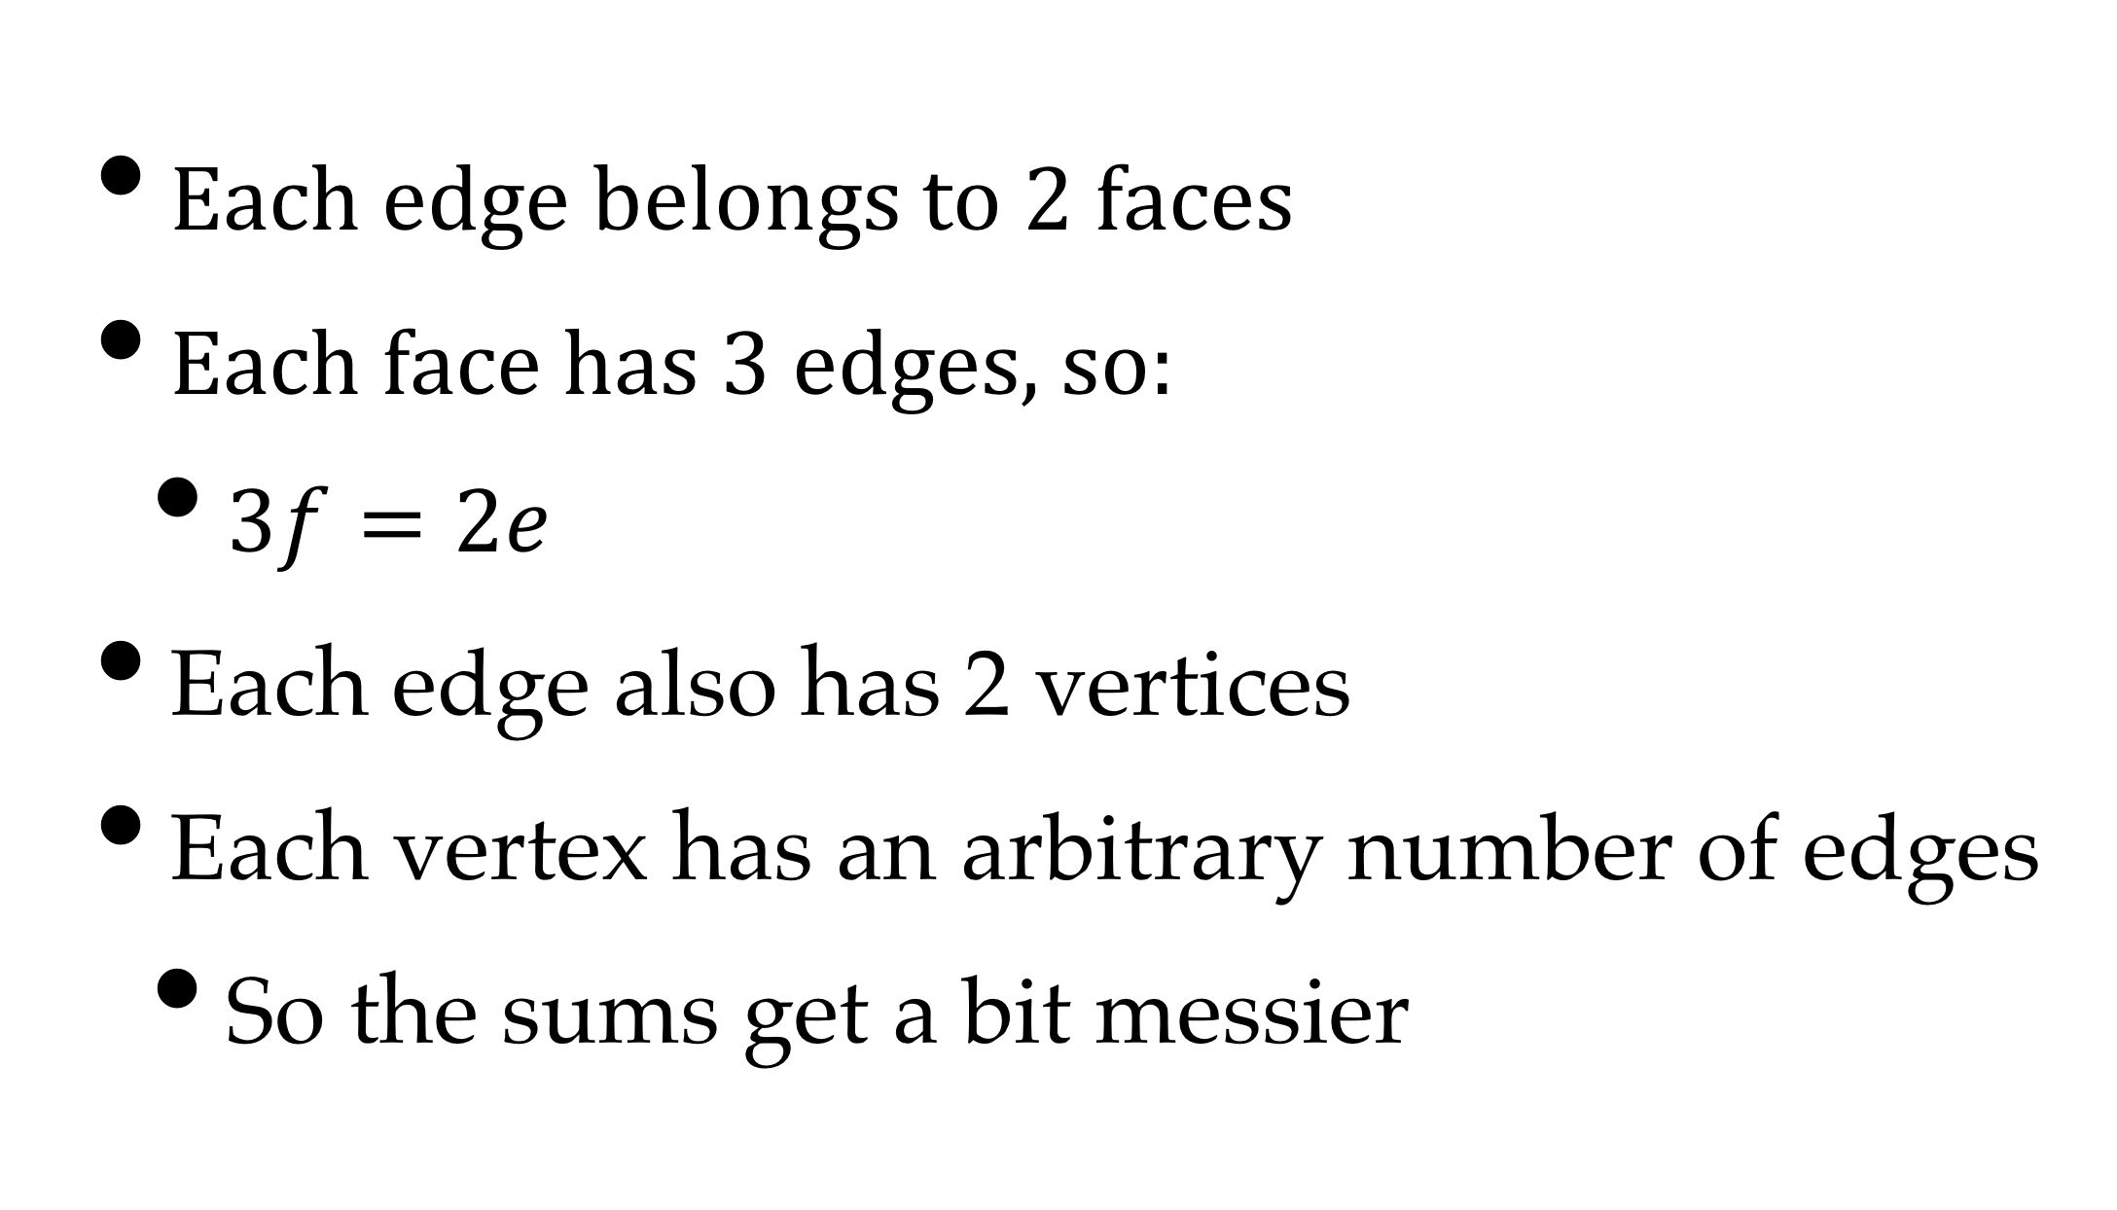
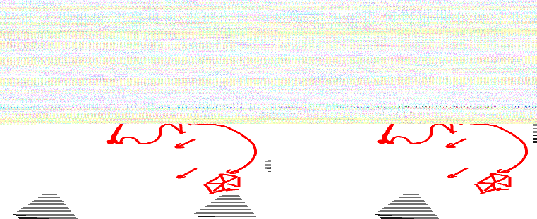
Edges & Faces
Each edge belongs to 2 faces
Each face has 3 edges, so:
$3f=2e$
Each edge also has 2 vertices
Each vertex has an arbitrary number of edges
So the sums get a bit messier

Slide 32
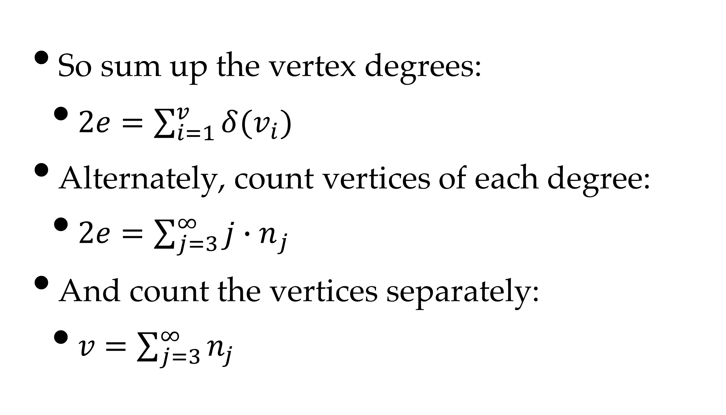

Edges & Vertices
So sum up the vertex degrees:
$2e=\sum_{i=1}^{v}{δ(v_{i})}$
Alternately, count vertices of each degree:
$2e=\sum_{j=3}^{∞}{{j∙n}_{j}}$
And count the vertices separately:
$v$ $=\sum_{j=3}^{∞}{n_{j}}$

Slide 33
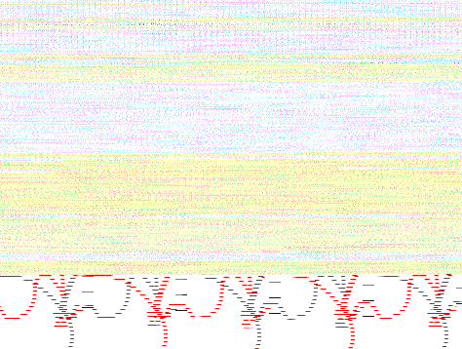
Substitutions

Slide 34
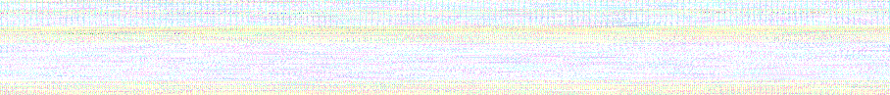
Consequences
There is always a vertex of degree 3, 4, or 5
at least in a planar graph / genus 0 surface
The only ways the mesh can get bigger
by adding degree 6 vertices
or balancing high & low degree vertices
If genus is low (and it always is)
so we mostly ignore it

Slide 35

More Consequences
3v per face, 6f per vertex means that:
f ~ 2v, e ~ 3v
and everything scales on the # of vertices
The formula is a checksum for correctness!
A genus 1 surface (torus) can be regular
i.e. all vertices the same degree (6)
No others can, except small ones

Slide 36
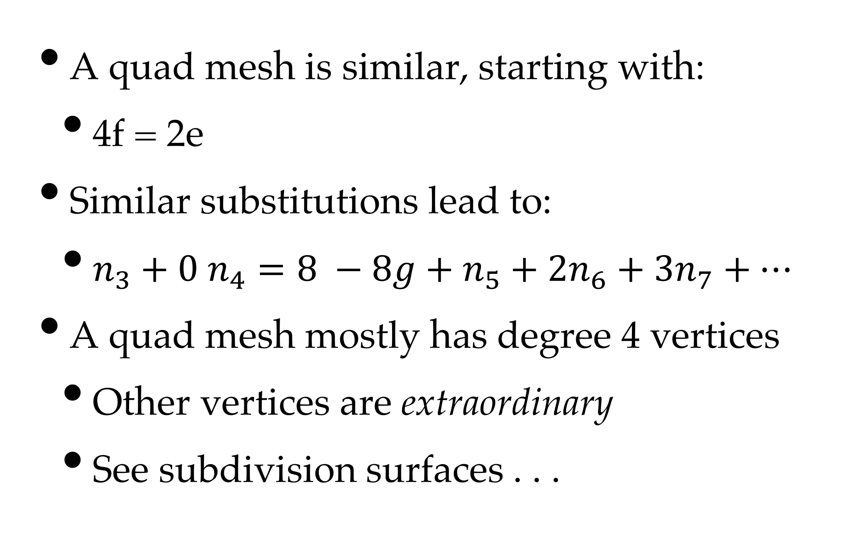
Quad Meshes
A quad mesh is similar, starting with:
4f = 2e
Similar substitutions lead to:
$n_{3}+0 n_{4}=8 −8g+n_{5}+2n_{6}+3n_{7}+⋯$
A quad mesh mostly has degree 4 vertices
Other vertices are extraordinary
See subdivision surfaces . . .

